Slide 1
DCC Spring Training Days 2026
Project Organisation:
From Raw Data To “Publication Package”
Part 1: Organising and tidying up data
Part 2: Publication package
Marta Kargól, Saxion UAS
Renate Mattiszik, Saxion UAS
Willemijn Plomp, Leiden University
28 May 2026
From: Mattiszik, R., Vermaas, M., & van de Sandt, S. (2024). Organizing your data and software with a reproducible project workflow - 2024 DCC Spring Training Materials (Versie 2024). Zenodo. https://doi.org/10.5281/zenodo.11061154

Slide 2
Schedule:
09.30 – 09.50 Opening and introduction
09.50 – 11.05 Part 1
11.05 – 11.15 Break
11.15 – 12.30 Part 2

Slide 3
Details of your data
 | Type (sensor readings, interview recordings, transcripts, survey output, literature output etc.) | File formats | Volume (GBs)
Raw data
Cleaned data
Final data

Slide 4
1. Save your project in a single folder.

Slide 5

My_project
README
data
tools
manuscript
Notes:
Start with your project in a single folder. Everything that relates to your project will be inside this folder. This will make your project portable and cohesive; it will make it easy for someone else to make sense of it. This is a habit that applies with projects anywhere, but particularly in research projects it contributes to their reproducibility, which is of course a vital component of good science.

Slide 6
2. Devise a logical system of subfolders.

Slide 7


README.md
LICENCE
data/
raw/ RAW_DATA_FILE001.zip
(…)
RAW_DATA_FILE331.zip
clean/
mydata.csv
R/
mycode.R
results/
images/
figure1.tiff
figure2.tiff
analysis/
tabel1.csv
docs/
documentation.md
manuscript.md
README.md
LICENCE
data/
mydata.csv
analysis/
report.md
Notes:
Make a logical system of sub folders, looking at what is standard in the field. There is no one-size-fits-all, but this can be a good structure for a research project. Having folders separate for data for documentation and for figures. Make sure you structure your sub folders in a logical way.
Don’t be afraid to make sub sub and sub sub sub folders, so long as it is logical.

Slide 8
README.md
LICENCE
data/
raw/ RAW_DATA_FILE001.zip
(…)
RAW_DATA_FILE331.zip
clean/
mydata.csv
R/
mycode.R
results
images/
figure1.tiff
figure2.tiff
analysis/
tabel1.csv
docs/
documentation.md
manuscript.md
README.md
LICENCE
data/
mydata.csv
analysis/
report.md
Notes:
Make a logical system of sub folders, looking at what is standard in the field. There is no one-size-fits-all, but this can be a good structure for a research project. Having folders separate for data for documentation and for figures. Make sure you structure your sub folders in a logical way.
Don’t be afraid to make sub sub and sub sub sub folders, so long as it is logical.

Slide 9
3. Introduce the project or subfolder in a README.

Slide 10
Documentation through README
What is the project about?
Who are involved?
How was the data collected?
When & where is the research conducted?
Other inspiration…
Abbreviations
Folder structure
File explanations
References & links
Take a look at: https://dcc-po.nl/publicaties/handleiding-datadocumentatie/ (in Dutch)
Notes:
Especially on higher levels, it’s recommended that each folder contains a description, or a README file, that describes the content of that folder. There are certain things you can put in that README file. A good thing to start with is always to ask yourself: what if, in one year time, you see this folder again, what information do you need to understand it fully? With almost everything we are going to show you, you yourself are the most likely the one to benefit from a good project structure, and good documentation. Keep this in mind.
Other content you can put in a README, aside from a general overview of the project, is: an explanation of any abbreviations used, the expected files and folders in your project and their purpose, names of contributors and their roles, and any links or references to important sources.

Slide 11
4. Use interoperable file types.

Slide 12
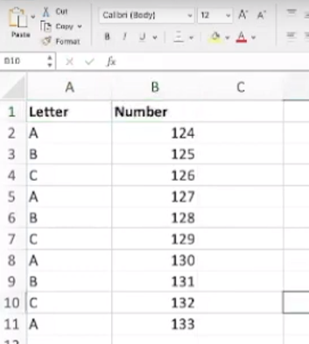
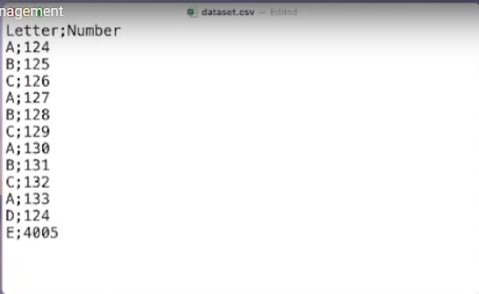
Notes:
Using Excel may be great for you now, with all its bells and whistles, but what if you leave your position and are no longer able to pay for the software. Can you still access your own data? What if someone who wants to reuse your project does not have access to Excel? And what happens to the file in 10 years? Would you feel confident that you can access and successfully read an Excel file from 10 years ago?
Instead, we recommend that you save data in a format that will work with Excel, but is not dependent on the software to be read. This format, .csv, takes the form of a table where items in different columns are separated by commas (or other characters). The data is stored in plain text, which allows it to be read by many different types of software, including a plain text editor. And, importantly, a .csv file will likely outlive you.
For almost any proprietary file type there is an interoperable alternative. Instead of a word document, save your text as a txt file, or perhaps formatted using Markdown. Information is ideally stored as plain text, but an interoperable file format can be different. The important thing is that it can be used by diverse platforms and applications, and does not require paid software to be accessible.

Slide 13
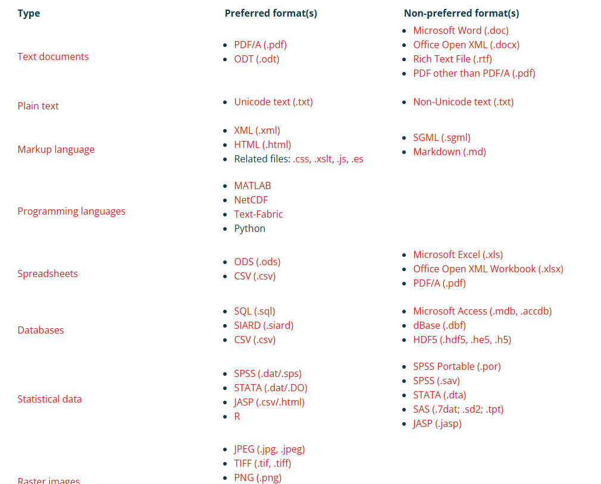
Preferred formats
(https://dans.knaw.nl/en/file-formats/)

Slide 14
5. Use descriptive and logical file names.

Slide 15
File names should be:
• Machine readable
• Human readable
• Logically sortable
Credit: Jenny Bryan
Notes:
File names themselves can be important documentation. We are long past the time that file names need to be short, although there is obviously a limit. A file name first of all is a description of the file that is tightly connected to that file. Filenames can be used to find the right data quickly amidst a jumble of files, or they can be used to identify the content of a stray file.
Naming a file right is therefore important

Slide 16
Avoid spaces, accents, odd
punctuation...
Use delimiters (hyphens, underscores) for easy
separation of elements
File names should be:
Machine readable
Human readable
Logically sortable
Use informative elements so that
files can be easily found
Credit: Jenny Bryan
Notes:
There are three main considerations to make. File names should first of all be machine readable. This means using a latin alphabet, with consistent capitalization, and no spaces or strange characters. When a filename contains important information about the content of that file, it can be used to quickly retrieve that file inside your system.

Slide 17
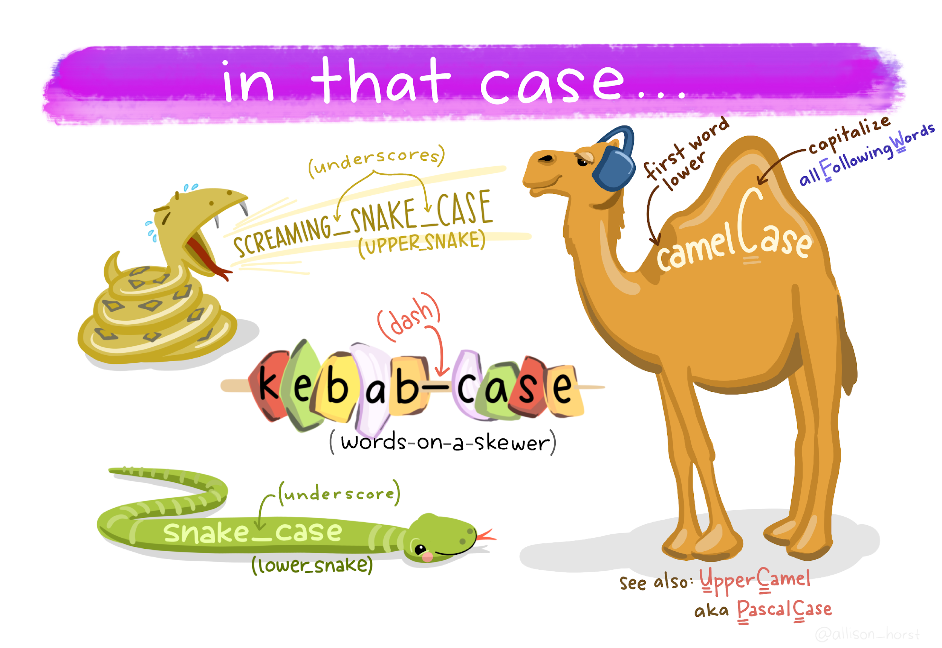
Credit: Allison Horst
Notes:
A filename does not need to be short, but words should never be separated by spaces. Instead use underscores (snake case), hyphens (kebab case), or consistent capitalization (camel case) to separate elements. Using hyphens or underscores has the added advantage that it is easy to separate elements automatically based on the patterns found in a name.

Slide 18
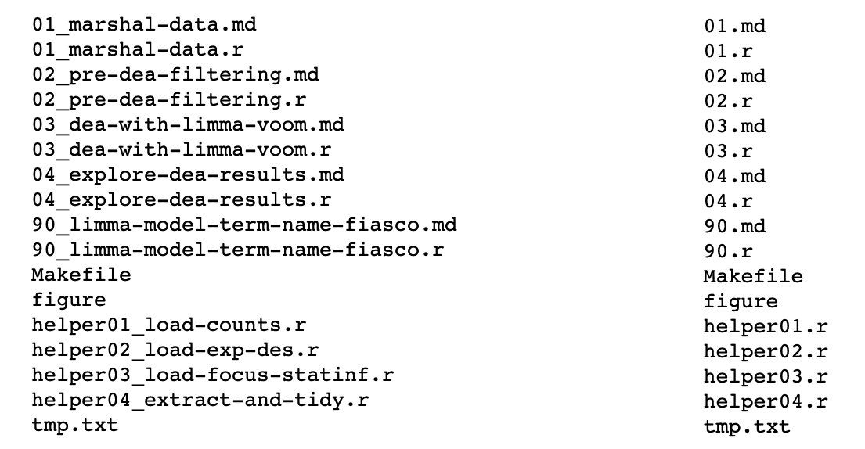
Which set of file(name)s do you want at 3 AM before a deadline?
File names should be
• Machine readable
• Human readable
• Logically sortable
Use informative elements
Credit: Jenny Bryan
Notes:
Most importantly though, file names should be intelligible for humans. That means that they should contain information that identifies the content of that file for you, or ideally another person. Jenny Bryan, who gave an excellent lecture about this, gave this example to drive that point home: what filenames would you rather see at 3AM before a deadline?

Slide 19
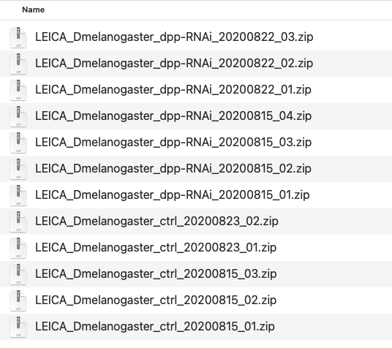
File naming
File names should be
• Machine readable
• Human readable
• Logically sortable
Notes:
Finally, file names will be important when you want to sort your files. Therefore, make sure that file names start with the most general descriptor of the file content. For example, when you are including a date in your file (and you probably should) start with the year, then the month, and then the day. This will make sure that when you are sorting your files, you will sort them chronologically, and not all the October files with other October files, for example. It also prevents any confusion with date notation in different parts of the world.

Slide 20
6. Make your data tidy.

Slide 21
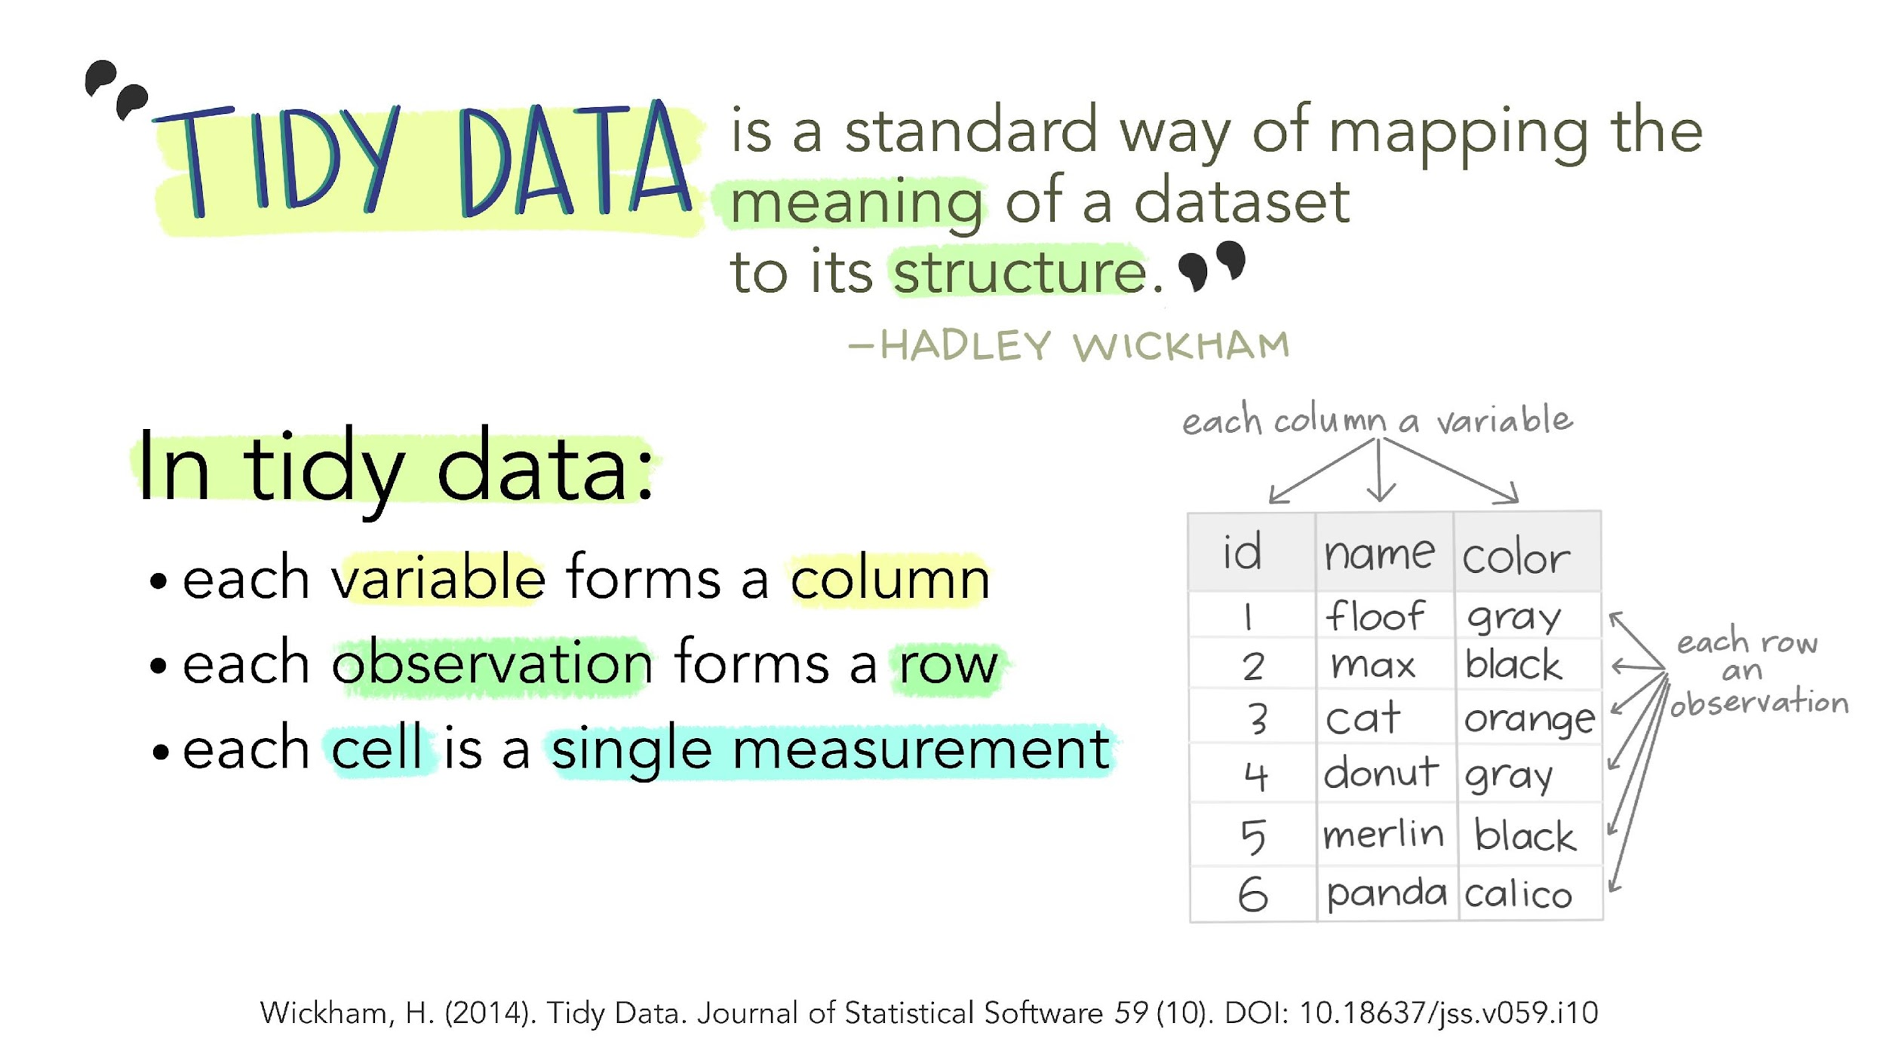

Slide 22
An example of untidy data: Weather measurements
Sensor_id | Temp day 1 | Sun day 1 | Temp day 2 | Sun day 2
NY_01 | 26 | 189 | 25 | 594
Amst_01 | 12 | 2,8 | 16 | 0,7
NY_02 | 30 | 254 | 15 | 5

Slide 23
An example of untidy data: Weather measurements
Sensor_id | Temp day 1 | Sun day 1 | Temp day 2 | Sun day 2
NY_01 | 26 | 189 | 25 | 594
Amst_01 | 12 | 2,8 | 16 | 0,7
NY_02 | 30 | 254 | 15 | 5

Slide 24
An example of untidy data: Weather measurements
Values in column names
Sensor_id | Temp day 1 | Sun day 1 | Temp day 2 | Sun day 2
NY_01 | 26 | 189 | 25 | 594
Amst_01 | 12 | 2,8 | 16 | 0,7
NY_02 | 30 | 254 | 15 | 5

Slide 25
An example of untidy data: Weather measurements
Multiple observations in a single row
Sensor_id | Temp day 1 | Sun day 1 | Temp day 2 | Sun day 2
NY_01 | 26 | 189 | 25 | 594
Amst_01 | 12 | 2,8 | 16 | 0,7
NY_02 | 30 | 254 | 15 | 5

Slide 26
README:
Temp = Celsius
Sun = minutes of sunshine/day
Sensor_id | Element | Day | Measurements
Amst_01 | Temp | 1 | 12
Amst_01 | Sun | 1 | 168
Amst_01 | Temp | 2 | 16
Amst_01 | Sun | 2 | 42
NY_01 | Temp | 1 | -3
NY_01 | Sun | 1 | 189
NY_01 | Temp | 2 | -4
NY_01 | Sun | 2 | 594
NY_02 | Temp | 1 | -1
NY_02 | Sun | 1 | 254
NY_02 | Temp | 2 | 15
NY_02 | Sun | 2 | 300

Slide 27
Same data, now in a tidy format
README:
Temp = Celsius
Sun = minutes of sunshine/day
sensor_id | Day | Temp | Sun
Amst_01 | 1 | 12 | 168
Amst_01 | 2 | 16 | 42
NY_01 | 1 | -3 | 189
NY_01 | 2 | -4 | 594
NY_02 | 1 | -1 | 254
NY_02 | 2 | 15 | 300

Slide 28
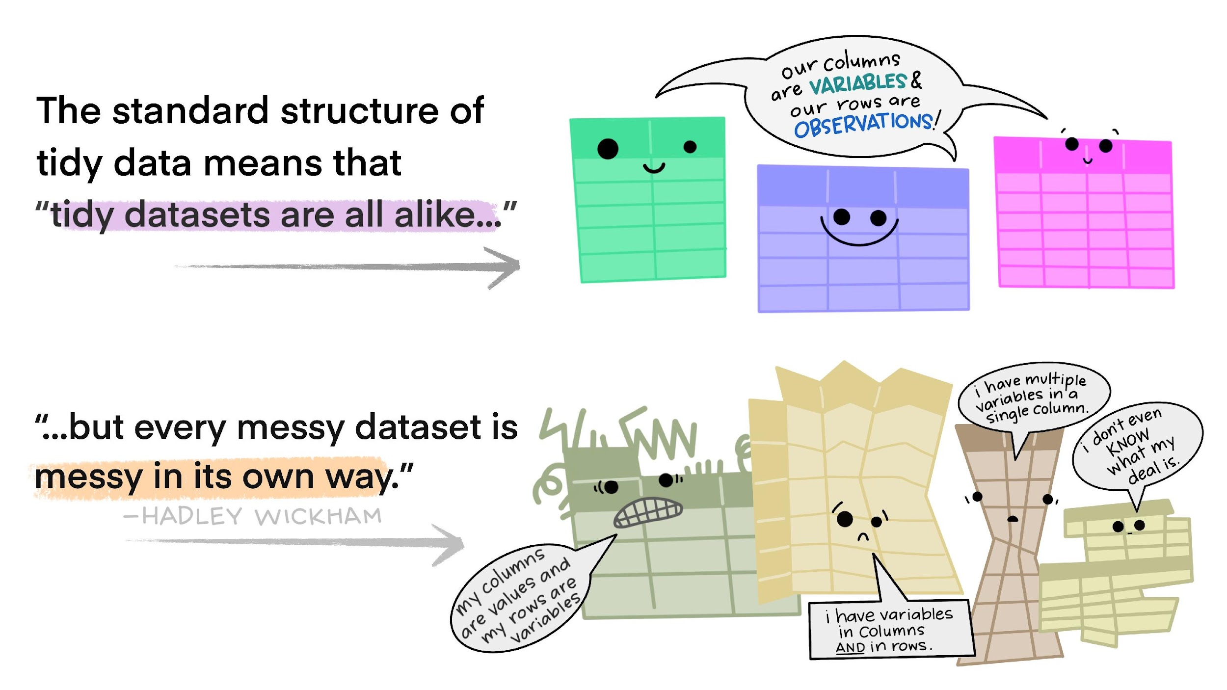
Visualization credit: Illustrations from the Openscapes blog Tidy Data for reproducibility, efficiency, and collaboration by Julia Lowndes and Allison Horst
Notes:
The tidy format standardizes the structure of the data, making it more straightforward to interpret and to run analyses on.

Slide 29
Save your project in a single folder.
2. Devise a logical system of subfolders.
3. Introduce the project or subfolder in a README.
4. Use interoperable file types.
5. Use descriptive and logical file names.
6. Make your data tidy.

Slide 30

Data cleaning exercise
Photo by https://stockcake.com/i/team-analyzing-documents_1223301_702038
Notes:
That same data can be put in a tidy format. No data is lost, though it looks different.
Link naar git hub
Wood duck data
uitpakken,
opschonen,
naamgeving,
mappenstructuur
Voorkeursformaten?
Readme file

Slide 31
Exercise
Individual ID | Mass | Average Ambient Temperature | Average Incubation Temperature | Incubation Period (days) | number of eggs | number of eggs hatched | Nest initiation day of year
H3 | 545 | 18.31 | 34.73 | 29.63 | 9 | 7 | 82
A1B | 645 | 22.46 | 32.09 | 32.04 | Probably 14 | 11 | 100
N4 | 605 | 14.44 | 31.96 | 32.42 | 17 | 14 | 57
N8 | 590 | 20.13 | 35.6 |  | 4 | 4 | 86
O2 | 540 | 19.74 | 31.34 | 33.71 | 13 | 10 | 86
U10C | 0.55 | 22.80 | 34.27 | 31.92 | 9 | 6 | 94
O3A | 560 | 13.04 | 33.56 | no | 5? | 4 | 55
O3B | 0.56 | 24.58 | 33.52 | 30.04 | 13 | 11 | 117
T2B | 0.57 | 25.28 | 35.97 | 29.54 | 7 | 6 | 119
T6A | 0.53 | 13.90 | 34.48 | 30.13 | 7 | 3 | unknown
T9 | 0.57 | 19.23 | 31.94 | none | 14 | 11 | 71
Notes:
That same data can be put in a tidy format. No data is lost, though it looks different.

Slide 32
Exercise
Individual ID | Mass | Average Ambient Temperature | Average Incubation Temperature | Incubation Period (days) | number of eggs | number of eggs hatched | Nest initiation day of year
A1B | 645 | 22.46 | 32.09 | 32.04 | Probably 14 | 11 | 100
H3 | 545 | 18.31 | 34.73 | 29.63 | 9 | 7 | 82
N4 | 605 | 14.44 | 31.96 | 32.42 | 17 | 14 | 57
N8 | 590 | 20.13 | 35.6 |  | 4 | 4 | 86
O2 | 540 | 19.74 | 31.34 | 33.71 | 13 | 10 | 86
O3A | 560 | 13.04 | 33.56 | no | 5? | 4 | 55
O3B | 0.56 | 24.58 | 33.52 | 30.04 | 13 | 11 | 117
T2B | 0.57 | 25.28 | 35.97 | 29.54 | 7 | 6 | 119
T6A | 0.53 | 13.90 | 34.48 | 30.13 | 7 | 3 | unknown
T9 | 0.57 | 19.23 | 31.94 | none | 14 | 11 | 71
U10C | 0.55 | 22.80 | 34.27 | 31.92 | 9 | 6 | 94
Notes:
That same data can be put in a tidy format. No data is lost, though it looks different.

Slide 33

What questions do you have?

Slide 34


Break
Notes:
That same data can be put in a tidy format. No data is lost, though it looks different.

Slide 35
Deel 2: Publication package
Notes:
That same data can be put in a tidy format. No data is lost, though it looks different.

